Slide 1
Predict Stock Returns Using Machine learning
By: Team 7
Kuek Hui Li, Sharanya Basu
Notes:
Good Afternoon TA, My name is Hui Li and together with sharan we will be presenting on predicting stock returns using machine learning.

Slide 2
TABLE OF CONTENTS
01
02
03
04
05
PROBLEM DEFINITION
DATASET EXPLORATION & PREPARATION
EXPLORATORY DATA ANALYSIS
MODEL
ANALYSIS
FINAL TAKEAWAY
Notes:
Heres a brief overview of what we will be covering today

Slide 3


What is the situation?
1. Volatile
2. Uncertainty
Investor sentiment, economic data, liquidity levels, market structure, and behavioral biases.
This volatility can make it difficult to predict future price movements accurately.
Influenced by constantly changing market conditions, economic trends, global political development and company performance.
Notes:
First, lets introduce the problem at hand.
Stock prices can be highly volatile, due to various factors such as investor sentiment, economic data, liquidity levels, market structure, and behavioral biases. Positive or negative sentiment can drive buying or selling activity, while economic indicators and news events can impact market confidence. This volatility can make it difficult to predict future price movements accurately.
Next, Stock prices can be uncentain as it is influenced by constantly changing market conditions, economic trends, global political development and company performance.

Slide 4
OUR Goal
To predict stock returns and generate a buy-hold-sell strategy to maximise returns for the Istanbul Stock Exchange dataset.
Notes:
Hence, our goal is to predict stock returns and generate a buy-hold-sell strategy to maximise returns for the Istanbul Stock Exchange
Dataset.

Slide 5



Problem Definition
1
2
3
Which model is the best for predict the stock return?
How does model enhancement help change the prediction of the returns?
What is the impact of each index on the return?
Notes:
We will be exploring 3 problems. Firstly, What is the impact of each index on the return? Next, Which model is the best for predict the stock return? And lastly, How does model enhancement help change the prediction of the returns?

Slide 6
02
Dataset Exploration and preparation
Notes:
Now moving on to Dataset Exploration and preparation

Slide 7
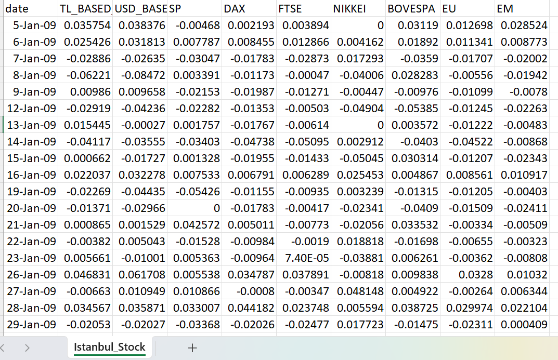
Dataset
Size of Dataset :
536 rows, 10 columns
Missing values : 0
Dataset range from June 5, 2009, to February 22, 2011
https://archive.ics.uci.edu/dataset/247/istanbul+stock+exchange
Notes:
The size the dataset has 536 rows and 10 columns with no missing values and understanding if the dataset has missing value is crucial as it can impact the accuracy and reliability of the analysis and modelling results.

Slide 8
Dataset
Columns | Chosen columns | Why?
Date | √ | To compute the average returns
TL_BASED_ISE | √ | We want compare our returns based on Turkish lira
USD_BASED_ISE | X | We will be predicting based on one currency, hence column not needed.
SP | √ | To predict returns
DAX | √ | To predict returns
FSTE | √ | To predict returns
NIKKEI | √ | To predict returns
BOVESPA | √ | To predict returns
EU | √ | To predict returns
EM | √ | To predict returns
Notes:
We need date to compute the average return , tl based to compare our returns on Turkish lira, we will be predicting based on one currency hence usd based column is not needed, then we would need all the index to predict stock returns.

Slide 9
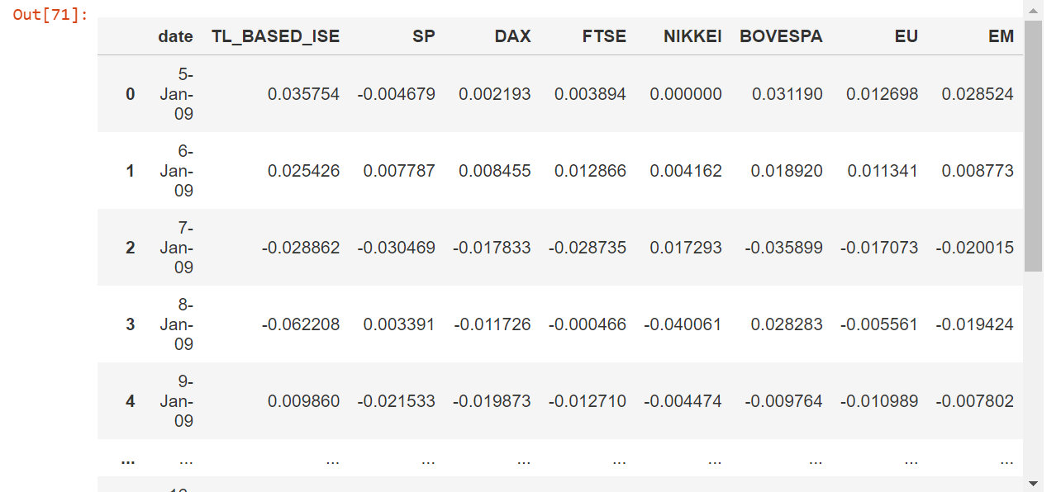
Data Cleaning
Eliminate irrelevant data: Drop USD_BASED_ISE column
We want to predict our return based on Turkish currency hence we decided to drop USD_BASED_ISE column.
Notes:
So here we form a dataframe and drop the USD_BASED column

Slide 10
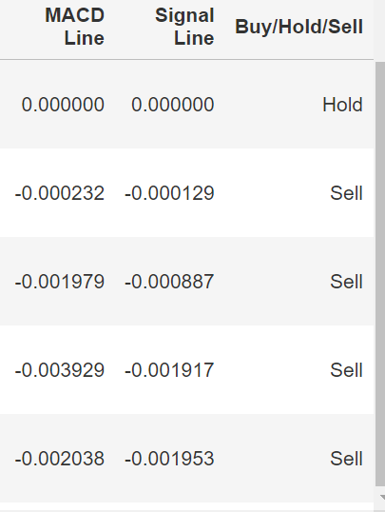
Feature Engineering
Calculate MACD line, Signal line and create buy/hold/sell column
The MACD line is a technical indicator that helps investors detect price trends, quantify trend momentum, and locate market entry points for buying or selling.
The MACD line is obtained by subtracting the 26-period exponential moving average (EMA) from the 12-period EMA.
The signal line represents the MACD line's nine-period EMA.
The Buy/Hold/Sell is added as a predicted indicator.
Notes:
We calculated the macd line and signal to create a buy/hold/sell column. The MACD line is a technical indicator that helps investors detect price trends, quantify trend momentum, and locate market entry points for buying or selling.
The MACD line is obtained by subtracting the 26-period exponential moving average (EMA) from the 12-period EMA.
The signal line represents the MACD line's nine-period EMA.
The Buy/Hold/Sell is added as a predicted indicator.

Slide 11
03
Exploratory Data Analysis
Notes:
Now moving on to the Exploratory Data Analysis

Slide 12
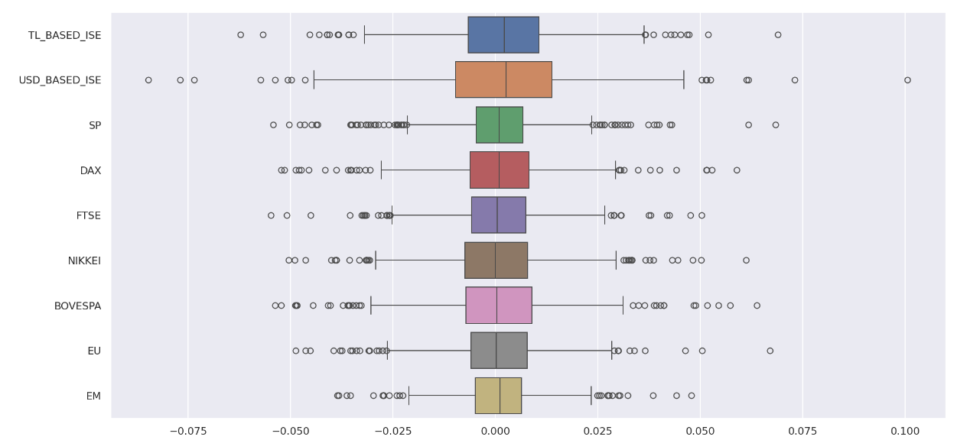
Explore the relationship of each index
Multiple outliers in all index
Notes:
We plotted the boxplot for all index and we can see that every index have multiple outliers
Change to boxplots and talk about the outliers distribution in each index

Slide 13
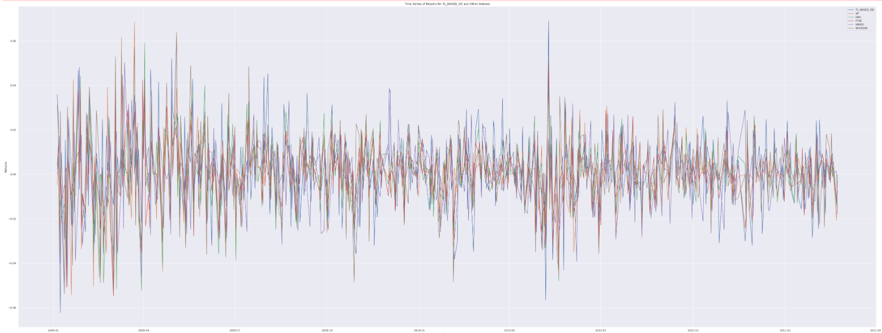
Explore the returns on time series
Plotting time series with returns and date with all index
Time series plots reveal seasonal or cyclical patterns in index performance.
Help us analyze how these events impact each index.
Shows that Istanbul stock is moving at an average price.
A few spikes (outliers)
Notes:
We then plotted the Time series with tl based return against date
This plots help us to identify the seasonal or cyclical patterns in index performance, Help us analyze how these events impact each index. Shows that Istanbul stock is moving at an average price and shows us that there were a few spike in the stock price.
Expand this plot + heatmap for the index and correlation

Slide 14
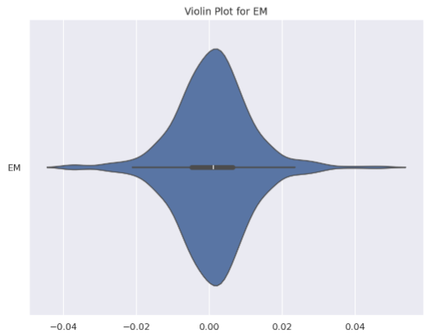
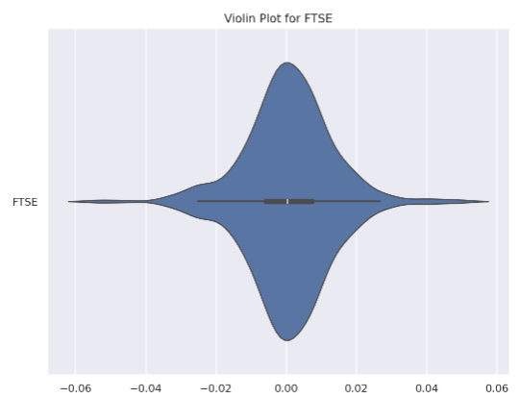
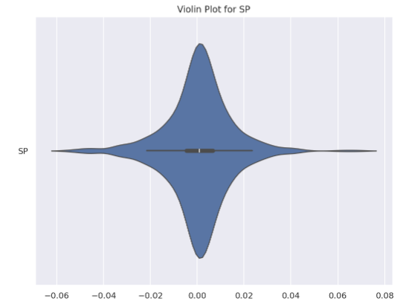
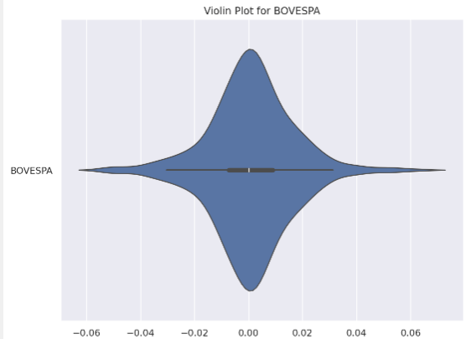
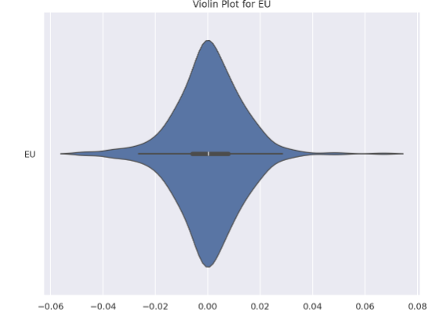
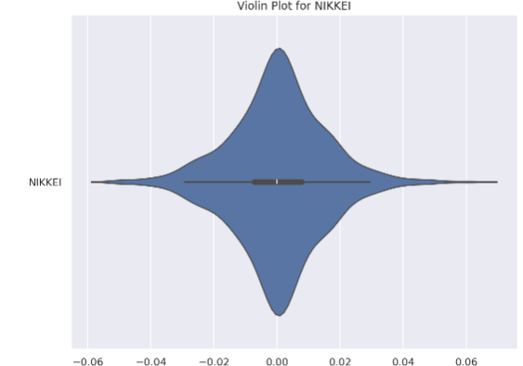
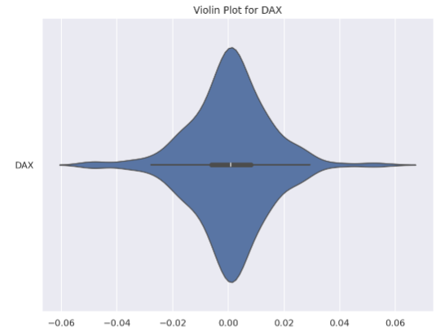
Explore the relationship of each index
Each index does not have significant different.
Similar overall performance in terms of stock returns.
Indicate similar levels of risk or volatility.
Notes:
We then plotted the violin plot and the from the violin plot we observed that Each index does not have significant different., Similar overall performance in terms of stock returns and it Indicate similar levels of risk or volatility

Slide 15
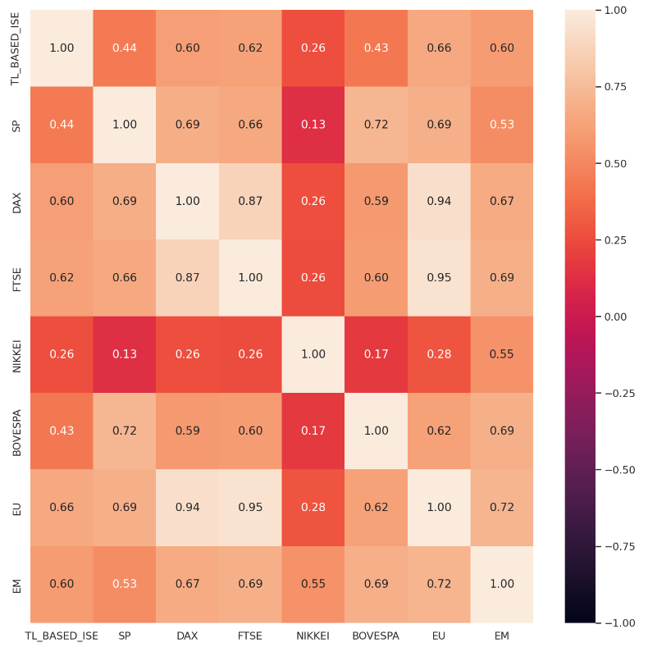
Explore correlation
Plotting Heatmap to understand the correlation
FSTE and EU shows the strong correlation with TL_BASED_ISE.
NIKKEI AND BOVESPA shows poor relationship with TL_BASED_ISE.
Notes:
We also plotted the heatmap to help understand the correlation between the index, from the heatmap , we can see that FSTE and EU shows the strong correlation with TL_BASED_ISE while NIKKEI AND BOVESPA shows poor relationship with TL_BASED_ISE.

Slide 16
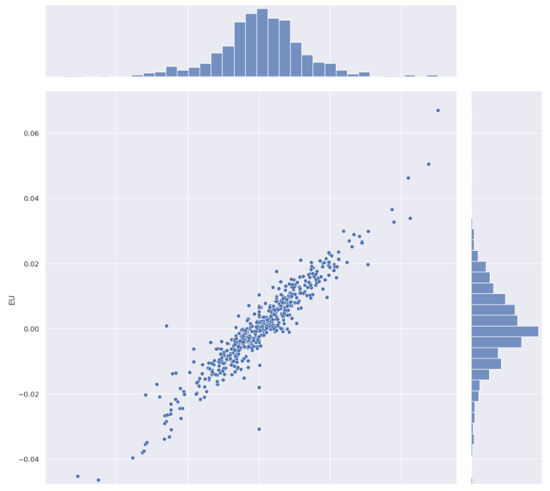
Explore correlation
Plotting joint plot for highest correlation
Chosen two index based on highest correction: FTSE and EU
FSTE and EU plotted on a joint plot to show a strong linear relationship between the variables.
Strongly impact MACD Line
Notes:
We chose the two highest correlation and plotted them on a joint plot. The FSTE and EU plotted on the joint plot to show a strong linear relationship between the variables and this also mean that this indexes Strongly impact MACD Line

Slide 17
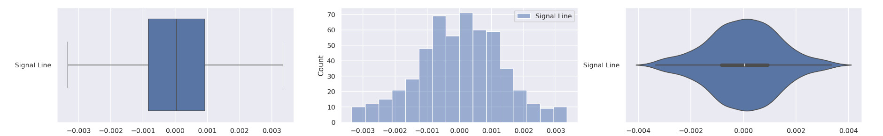
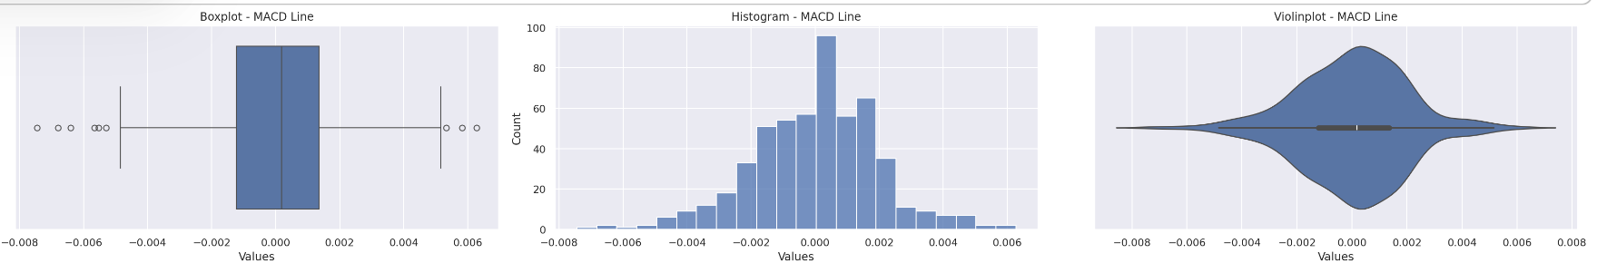
Exploration of the MACD Line vs Signal Line
Violin plot, box plot and histogram help us to visualize the distribution and shape of the data.
MACD have a narrower box plot and better violin plot
Choose MACD Line as our indicator.
Notes:
We plotted the macd line and signal line with Violin plot, box plot and histogram as it help us to visualize the distribution and shape of the data. The MACD have a narrower box plot and better violin plot. Hence, we decided to Choose MACD Line as our indicator.

Slide 18
Explore Best Indicators
Why MACD Line?
Reacts to price changes relatively quickly.
Help the models to understand the strength and direction of price movements.
Concentrated
Few outliers
Notes:
The macd line plots shows that it is concentrated and have a few outliers. Also we chose the macd line as it reacts to price changes relatively quickly.
Help the models to understand the strength and direction of price movements.
Will be able to distinguish between bullish and bearish trends based on crossovers and movements relative to the zero line.
Quantitative Data: The MACD line provides quantitative data based on historical price movements, making it a suitable input feature for machine learning models. Machine learning algorithms can learn from this historical data to identify patterns, trends, and relationships that contribute to predicting future stock returns.
Momentum Analysis: The MACD line captures market momentum by measuring the difference between short-term and long-term moving averages. This momentum analysis is crucial for machine learning models to understand the strength and direction of price movements, which are essential factors in predicting stock returns accurately.
Leading Indicator Properties: As a leading indicator, the MACD line reacts to price changes relatively quickly compared to lagging indicators. This property allows machine learning models to generate early signals of potential trend reversals or continuations, providing a competitive advantage in predicting stock returns before they occur.
Trend Identification: The MACD line's ability to identify bullish and bearish trends based on crossovers and movements relative to the zero line enhances machine learning models' capability to recognize and adapt to changing market trends. Incorporating trend identification into models improves their accuracy in predicting stock returns over different market conditions.

Slide 19
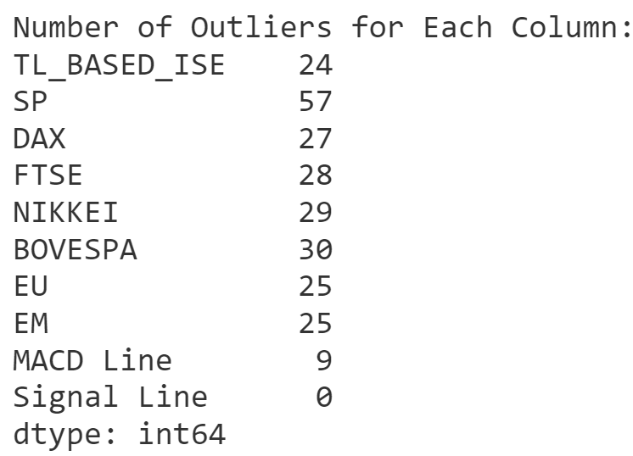
Explore outliers
Removing Outliers
Improve accuracy in predicting stock returns.
Improve the interpretability of the model's predictions.
Notes:
We can see that the macd line have 9 outliers and we decided to remove it as it will help us Improve accuracy in predicting stock returns and Improve the interpretability of the model's predictions
Improved Model Accuracy: Outliers can significantly skew statistical measures and distort the underlying patterns in the data. By removing outliers, predictive models can better capture the typical behavior of stock returns, leading to more accurate predictions.
Reduced Model Bias: Outliers can introduce bias into predictive models, especially if they are extreme values that do not reflect the general trends in stock returns. Removing outliers helps reduce this bias, allowing the model to focus on the majority of observations that are more representative of typical market behavior.
Stabilized Model Performance: Models that are trained on data with outliers may exhibit unstable or erratic performance, particularly when making predictions for new data points. Removing outliers can stabilize the model's performance by reducing the influence of extreme values that may not follow the overall trends in stock returns.
Risk Management: Outliers in stock returns often represent extreme market events or anomalies that may not be relevant for predicting future returns. Ignoring these outliers can lead to overly optimistic or pessimistic predictions, which can be detrimental for risk management strategies. Removing outliers helps create more realistic and actionable predictions for risk assessment and portfolio management.
Enhanced Interpretability: Predictive models based on data without outliers are easier to interpret and explain. Stakeholders, such as investors, analysts, and decision-makers, can have more confidence in the model's predictions and understand the reasoning behind them when outliers are appropriately handled or removed.

Slide 20
04
Model Analysis

Slide 21
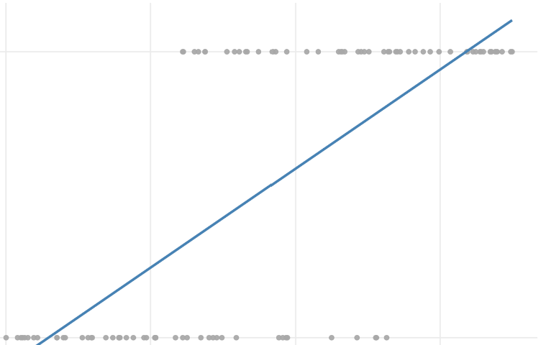
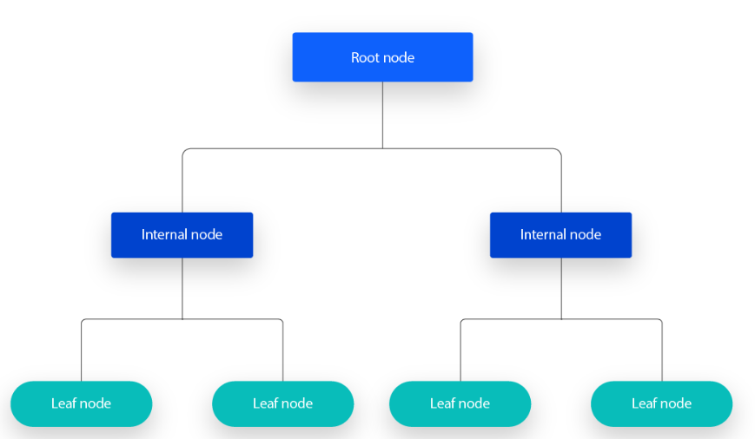
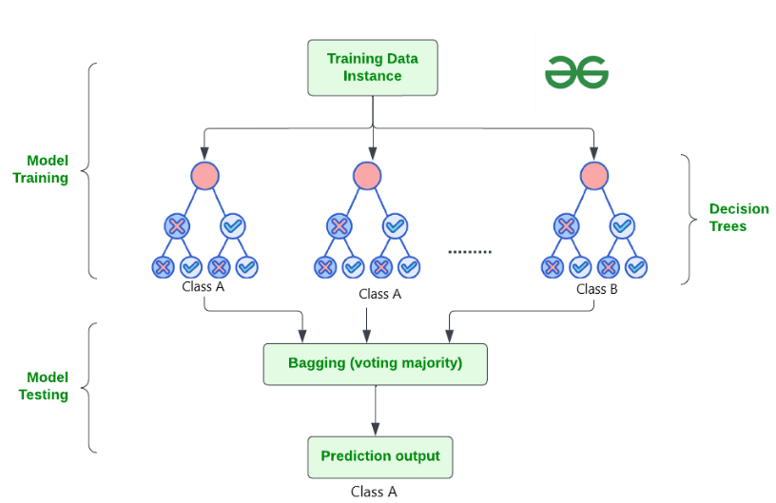
Machine Learning
Logistic Regression
Decision Tree
Random Forest
predicts the probability that an observation belongs to a particular category.
Provides metrics for assessing goodness of fit like accuracy, precision, recall, F1-score, ROC curve, and AUC-ROC.
Trees split nodes based on the best feature among the randomly selected data from the dataset, using criteria like information gain or Gini impurity for classification .
The root node is split into branches based on one of the input feature. The split process continues recursively until a criteria is met.
Notes:
Returns =
Accuracy of trainset =
Accuracy of testset =

Slide 22

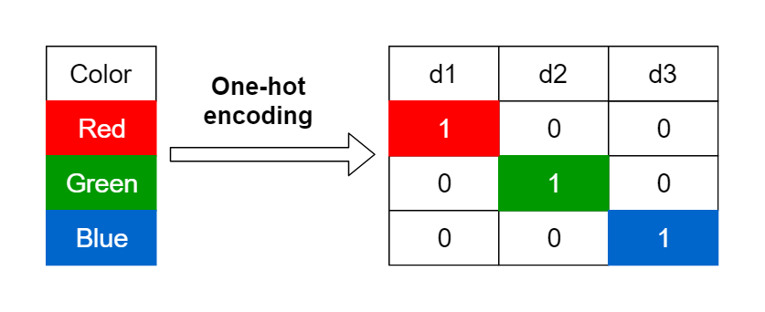
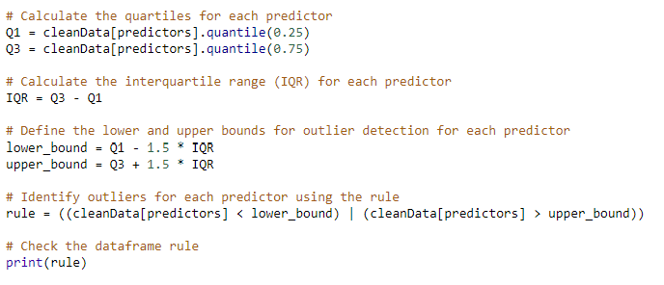


Enhancements
Outlier Removal
Label Encoding
Increase number of trees
Converts categorical variables into binary vectors.
In the binary vector, 1 indicates 'Buy' and 'Hold', while 0 indicates 'Sell'.
Helps machine learning algorithms process categorical data effectively."
Increasing the number of trees in ensemble models enhances predictive power.
100 to 1000 trees.
Balancing model complexity and computational resources is crucial.
Using IQR method to remove the outliers from each of the stock indexes
Total 95 data points removed.
441 rows in new dataset

Slide 23
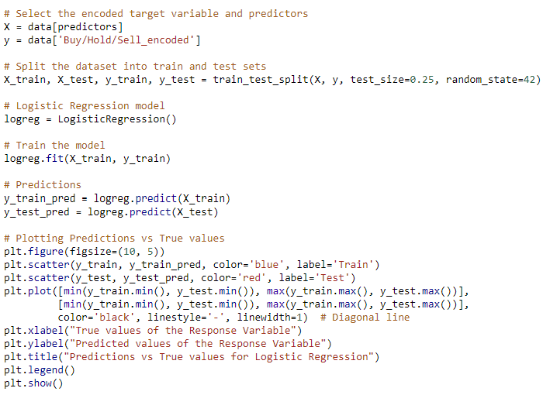
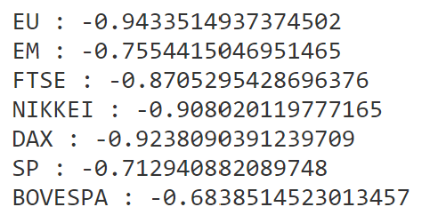
Logistic Regression Implementation
Full dataset with variables
Analysis
The negative coefficients for all predictors (EU, EM, FTSE, NIKKEI, DAX, SP, BOVESPA) indicate that as the values of these predictors increase, the likelihood the response variable being in the "Buy" category decrease.

Slide 24
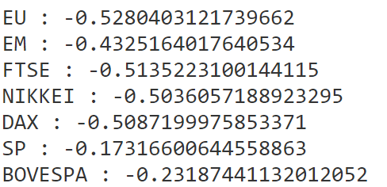
Logistic Regression Results
For coefficients, a similar trend as before.
The accuracy of the model on the test set has improved slightly to approximately 60.4%.
The precision, recall, and F1-score for class 1 (Buy) have increased, indicating better performance in predicting this class.
Model has a higher number of true positives and true negatives compared to false positives and false negatives --> increase in true positive rate by 0.0159.
 | precision | recall | F1-score | support
0 | 0.93 | 0.21 | 0.35 | 66
1 | 0.55 | 0.99 | 0.71 | 67
Wd. Avg. | 0.74 | 0.60 | 0.53 | 134
 | precision | recall | F1-score | support
0 | 0.73 | 0.16 | 0.27 | 49
1 | 0.59 | 0.95 | 0.73 | 62
Wd. Avg. | 0.65 | 0.60 | 0.52 | 111
Train Accuracy: 0.5895
Test Accuracy: 0.5970
Train Accuracy: 0.5878
Test Accuracy: 0.6036

Slide 25
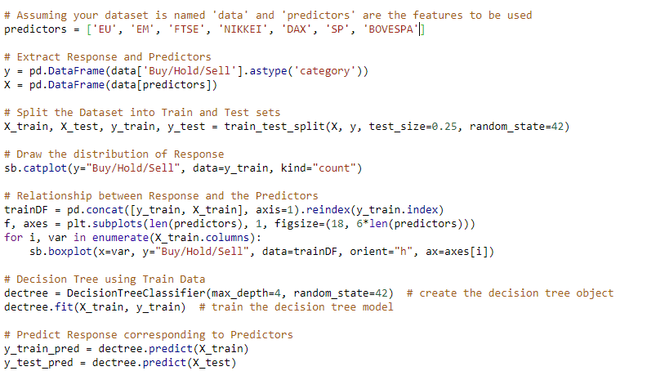
Decision Tree Implementation
Full dataset with variables
Analysis
The depth of the tree (max depth) controls the complexity of the model, preventing it from overfitting by limiting the number of levels in the tree, optimising accuracy of the model.
Tree pruning

Slide 26
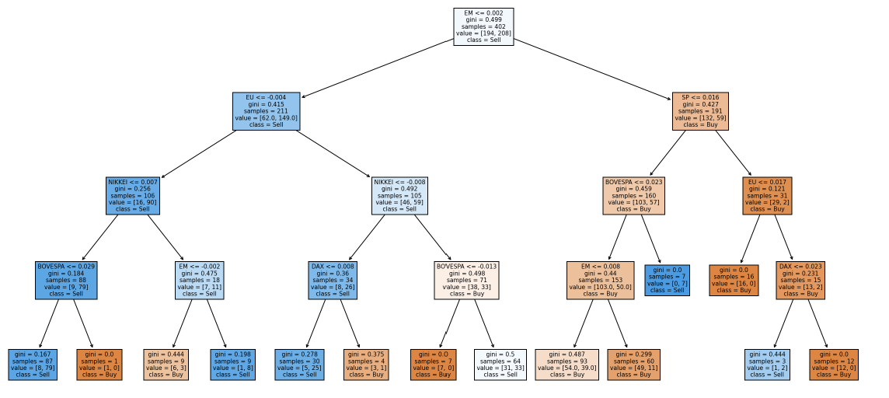
Decision Tree Result
Goodness of Fit of Model Train Dataset Classification Accuracy : 0.7512
Goodness of Fit of Model Test Dataset Classification Accuracy : 0.6417
TPR = 0.7403 , FPR= 0.2371
We can trace the path to indicate the decisions of when to buy or sell the stocks based on the terminal nodes with low gini index.
Most influential stocks are EM, EU and SP.

Slide 27
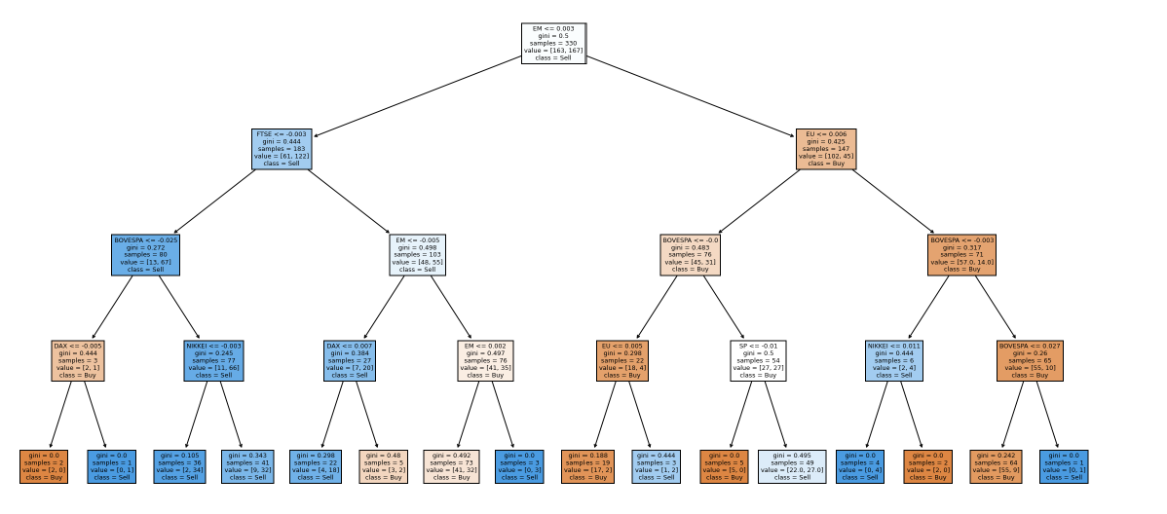
Decision Tree Results after Enhancement
Goodness of Fit of Model Train Dataset Classification Accuracy : 0.7484
Goodness of Fit of Model Test Dataset Classification Accuracy : 0.5495
TPR = 0.7305 , FPR=0. 2331
The model has 5 levels.
Most influential stocks are EM, EU and FTSE.
However, improvements decreased the accuracy of the model. Hence, it is not suited well for stock prediction.

Slide 28
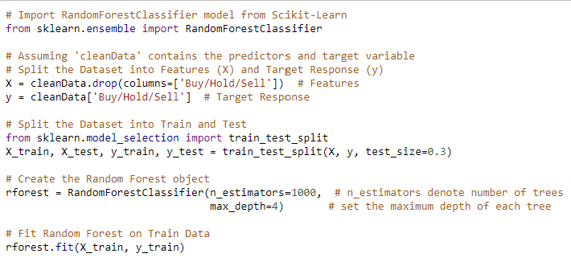
Random Forest Implementation
Full dataset with variables
Analysis
Ensemble of 500 decision trees.
More stable than 1 decision tree model.
More accurate than 1 decision model.
Will not overfit the data points.

Slide 29
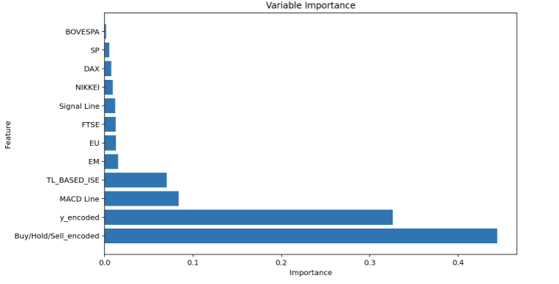
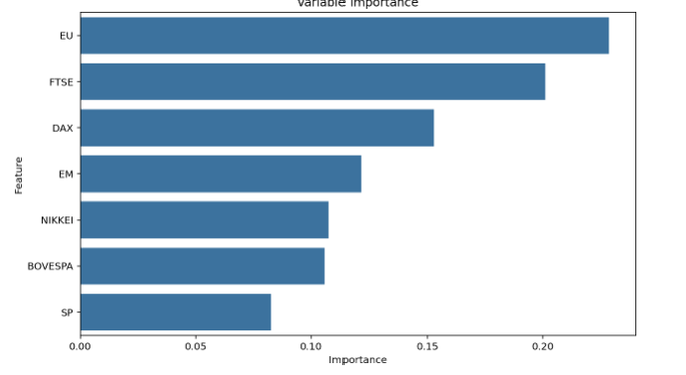
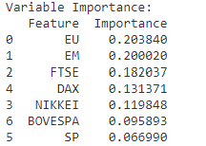
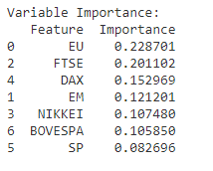
Random Forest Results
Model 1:
TPR : 0.9393
FPR : 0.8926
Overall Classification Accuracy: 0.8198
Model 2:
Classification Accuracy:
0.6466
TPR : 0.7668
FPR : 0.1724
In the improved model, the most influential indexes include the EM, FTSE and EU indexes.
With the relatively high accuracy of the model, we can understand that the stock returns are highly dependent on these three factors.

Slide 30


Comparison of models + Insights
Insights
Comparison
Model | True Positive | False Positive
Lg.Reg. | 0.9759 | 0.8247
Lg Reg Imp. | 0.9516 | 0.8367
RF | 0.9393 | 0.8926
RF Imp | 0.7668 | 0.1724
Decision Tree | 0.7403 | 0.2371
Decision Tree imp | 0.7305 | 0.2331
Model | Variables | AUC | Accuracy
Lg.Reg. | Indexes | - | 59.7%
Lg Reg Imp. | Indexes | 0.7349 | 60.4%
RF | Indexes | - | 91.73%
RF Imp | Indexes | 0.7274 | 64.66%
Decision Tree | Indexes | - | 69.6%
Decision Tree imp | Indexes | 0.7487 | 64.8%
Higher cost of false positives due to sensitivities in stock returns
Low risk investor-based analysis: go for models with low false positive rates.
The best performing models are the random forest models and the decision tree before improvements.
Highest Accuracy: 91.73%

Slide 31
05
Final Takeaways

Slide 32
Recommendations
Which model is the best for predict the stock return?
How does model enhancement help change the prediction of the returns?
What is the impact of each index on the return?
In some cases, like logistic regression it increased accuracy. However, for decision tree and random forest, it decreased the accuracy.
Decision Tree has the highest accuracy and is the best model for predicting stock returns.
EM, EU and FTSE are seen to have significant impact on stock returns using the MACD line.

Slide 33
Conclusion
From our analysis, we can conclude the following:
Some models are better suited to predict stock returns due to its highly volatile nature and complex variables.
The indicators used to measure the stock returns need to be chosen carefully to represent the decision of buying, holding or selling.
Some stocks are highly influential to the MACD line as shown consistently across all the models.
For the decision tree and random forest, it was unexpected that the label encoding and outlier removal would decrease accuracy.
For investors in the Istanbul stocks, they should focus on EM, EU and the FTSE stocks carefully and follow the decision tree to decide when to buy hold or sell their stocks.
Some other considerations could be time periods and focusing on micro trends instead of only long-term trends.

